Slide 1
Do not delete this slide.
This slide is designed so that you can copy the prompt box you need and insert it into your slides.
This slide is hidden and will not be included when presenting your lesson.
TRACK WITH ME
VOCABULARY
1 -
HINT
Students, remember….
CHECK FOR UNDERSTANDING
READ WITH ME
TEACHER CUE
MAKE THE CONNECTION
Students, you already know….
EXTENSION
GESTURE WITH ME

Slide 2
Jigsaw
+
Skulls
This PPT is 2 lessons: (combined with Bird Beak Engagement Activity)

Slide 3
Genetic variation is driven by:
Gene flow
Sexual reproduction
Mutations

Slide 4
6 minutes in Expert Groups
10 minutes back at Home Group

Slide 5
The Theory Of Natural Selection: What do you know? (Diagnostic Test)
10 minutes – in silence
We will mark it as a class once finished

Slide 6
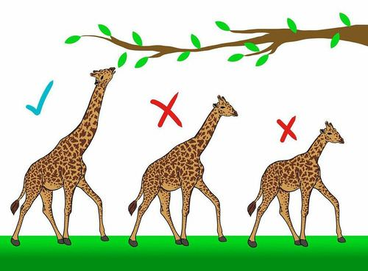
Natural Selection
We will investigate the theory of natural selection
Notes:
Insert cover image and use transparency settings to fade image.

Slide 7
We will investigate the theory of natural selection
TRACK WITH ME
READ WITH ME
Explain how natural selection drives evolutionary change.
Understand the requirements needed for natural selection to occur.
Notes:
Learning Objectives contain concepts (nouns, big ideas), skills (verbs, measurable behaviours) and sometimes context (restricting or targeting conditions).
●Example: Students will be able to describe the concept of density and apply it to floating and sinking.
●
Success criteria are specific measurable outcomes that if met mean that the student has met the learning objective.
Examples:
•Students will be able to compare densities of substances using mass and volume.
•Students will be able to identify whether a solid or liquid will float or sink in a liquid based on their densities.

Slide 8
Scientific theory
An explanation that is based on a sufficient amount of evidence.
Theory of gravity, cell theory, the Big Bang, atomic theory, theory of evolution

Slide 9
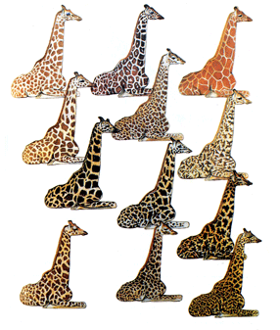
Variation
Variation is the existence of variety and differences within and between species.

Slide 10
Before the theory of evolution was adopted, society believed the following…
A divine creator (God) was responsible for everything
There were species that never changed
The Earth was only 6000 years old
Each species was perfectly and intentionally designed (flaws and all)
What do you think about these now? Discuss

Slide 11
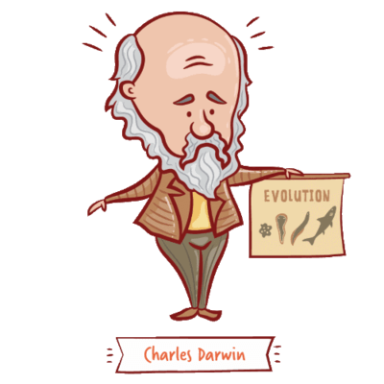
Natural Selection was first proposed by Charles Darwin.
Darwin’s idea was that populations typically produce more offspring than the surrounding environment can support. As a result, there is competition for survival.

Slide 12
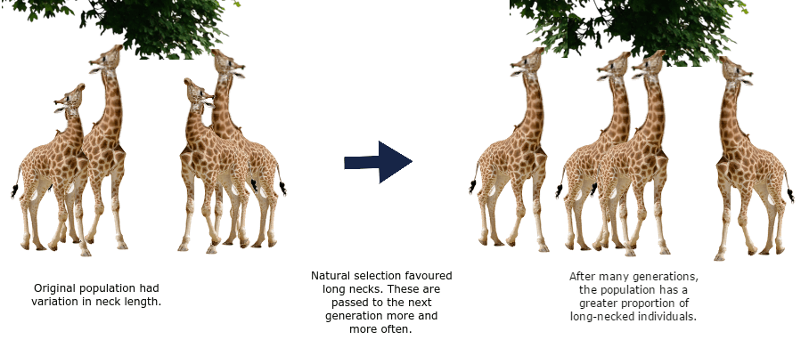
Natural selection is the increase or decrease in the frequency of certain alleles within a population.
The change in alleles may be caused by biotic (living) or abiotic (non-living) pressures.

Slide 13
Organisms with beneficial phenotypes will be better equipped to survive, reproduce, and therefore pass their advantageous genes on.
Over time, advantageous genes become more common in the gene pool.

Slide 14
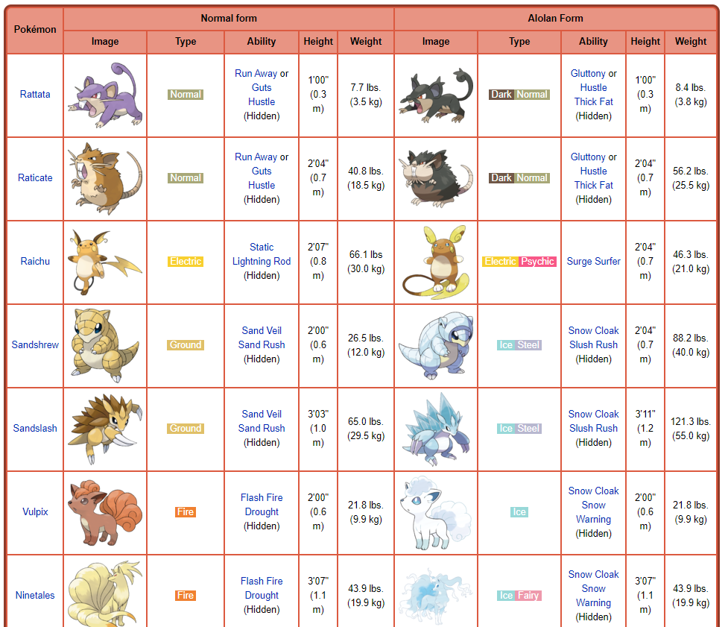
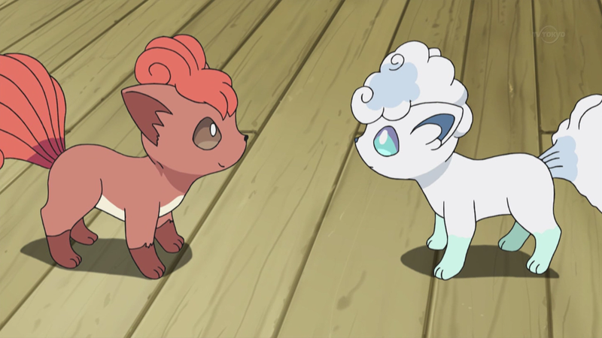
https://youtu.be/0SCjhI86grU?t=137
Natural selection can appear random, due to having no specific end goal aside from making organisms best suited to their environment.
It is a process in which an organism adapts, through nature selecting for genes that code for advantageous phenotypes.
https://www.youtube.com/watch?v=7VM9YxmULuo

Slide 15
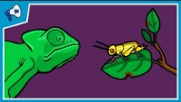

Slide 16
https://www.youtube.com/watch?v=jD8w3SOlYOk
These are the same species of moth, which would be able survive on a pale tree?
Which would survive better on a darker tree?

Slide 17
Evolution of the Peppered Moth
Cut out the paragraphs and stick them in order in your books. Draw a picture above each paragraph to illustrate what is happening.
When this darker moth rests on a tree trunk it is spotted by a bird and eaten.
1850 The industrial revolution has started. Factories are producing huge amounts of pollution and the trees are going black.
1700 Peppered moths are a pale brown colour. They like to rest on the trunks of trees where they are well camouflaged.
The pale brown peppered moths are no longer safe resting on tree trunks. Their numbers decline.
Occasionally there is a mutation in the colour of the peppered moth and it is born a darker colour.
The species of peppered moth has evolved.
However, the mutant black moths are now better adapted and are camouflaged on the tree trunks. They survive to breed and pass on their genes.

Slide 18
We will investigate the theory of natural selection
TRACK WITH ME
READ WITH ME
Explain how natural selection drives evolutionary change.
Understand the requirements needed for natural selection to occur.
Notes:
Learning Objectives contain concepts (nouns, big ideas), skills (verbs, measurable behaviours) and sometimes context (restricting or targeting conditions).
●Example: Students will be able to describe the concept of density and apply it to floating and sinking.
●
Success criteria are specific measurable outcomes that if met mean that the student has met the learning objective.
Examples:
•Students will be able to compare densities of substances using mass and volume.
•Students will be able to identify whether a solid or liquid will float or sink in a liquid based on their densities.

Slide 19
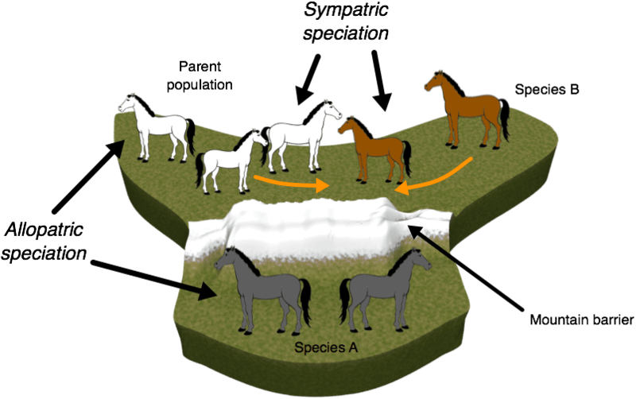
Several processes are involved in natural selection:
Variation
Isolation and Competition
Selection
Given enough time with the above, speciation can occur (or the formation of a new species)

Slide 20
Variation
Populations must have existing variation for natural selection to occur.
Variation is when a population has a range of different phenotypes, due to large genetic diversity, or range of genes available.
This is so phenotypes that aid survival are available to be selected for, if the environment changes.

Slide 21
Variation
Genetic diversity is necessary to avoid extinction when selection pressures change.
If the advantageous gene already exists in the gene pool, organisms with this gene can survive and reproduce, and make the advantageous allele more common.

Slide 22
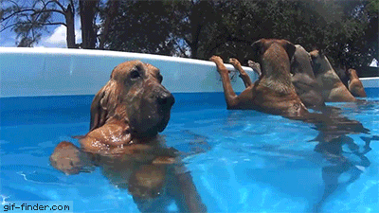
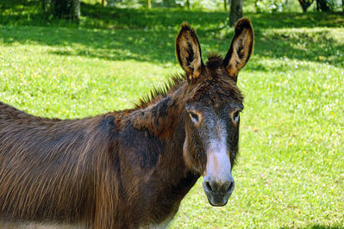
Isolation and Competition
Although different breeds of dogs look very different, they are still able to reproduce viable offspring, so are the same species.
Donkeys and horses however, can produce offspring, but these offspring (mules) cannot reproduce themselves (are not viable). Therefore, horses and donkeys are classed as two different species.

Slide 23
Isolation and Competition
The population on which natural selection is acting must be isolated from other populations of the species, often geographically.
If the two populations are not isolated, then genes will pass between the two populations via interbreeding and gene flow, and the two populations will not become two different species.

Slide 24
TEACHER CUE
Competition Simulation Class variables
Isolation and Competition
Competition between organisms can occur for food, mates and habitats.
Weaker organisms are likely to be outcompeted, and will often die before being able to pass on their genes.
This is necessary because it means only organisms with phenotypes advantageous to survival, will live to reproduce and pass on their genes.

Slide 25
Selection
The final requirement for natural selection is selection.
Selection pressure is a force that favours organisms with advantageous genes (and therefore phenotypes) over those without them.
This causes the allele frequency of a population to change, with the advantageous variation of a gene becoming more frequent.

Slide 26
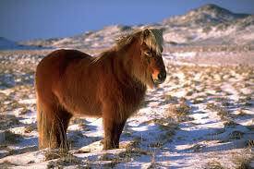
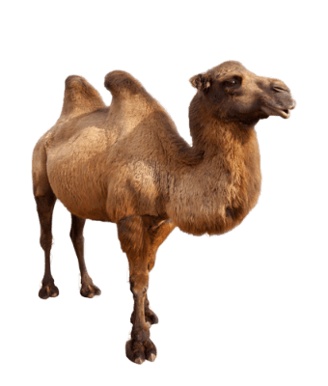
For example: a cold climate is a selection pressure from nature for thick fur.
A hot and dry climate is a selection pressure for needing to drink very little water, as with camels.

Slide 27
Speciation is the process by which one species splits into two or more separate species.
If enough natural selection of desirable phenotypes occurs, the end result can be speciation.
PRE-LAB HANDOUT
FURTHER DISCUSSION NEXT LESSON
+ EVIDENCE FOR EVOLUTION

Slide 28
We will investigate the theory of natural selection
TRACK WITH ME
READ WITH ME
Explain how natural selection drives evolutionary change.
Understand the requirements needed for natural selection to occur.
Do Now:
Complete your exit ticket for today
Glue the exit ticket sheet in your books
Homework: Education Perfect Mechanisms of Evolution: Natural Selection
I need to see your exit ticket before you pack up to leave.
Notes:
Learning Objectives contain concepts (nouns, big ideas), skills (verbs, measurable behaviours) and sometimes context (restricting or targeting conditions).
●Example: Students will be able to describe the concept of density and apply it to floating and sinking.
●
Success criteria are specific measurable outcomes that if met mean that the student has met the learning objective.
Examples:
•Students will be able to compare densities of substances using mass and volume.
•Students will be able to identify whether a solid or liquid will float or sink in a liquid based on their densities.

